Slide 1


Slide 2
Selenium Training
VIKRAM Kamalesh
Evry

Slide 3
Agenda
Automation Basics
What is Selenium?
Selenium components
Selenium IDE
Selenium Commands
Selenium WebDriver
Element Locators
Xpath
Developer Tools

Slide 4
What is Automation?
• Automated testing is a process in which software tools execute pre-scripted tests on a software application.
• Test cases are executed with the assistance of tools, scripts, and software.
• Automated testing tools are capable of executing tests, reporting outcomes and comparing results with earlier test runs. Tests carried out with these tools can be run repeatedly.

Slide 5
What to Automate?
• Static and Repetitive Tests
• Regression Testing
• Smoke Testing
• Data Driven Testing

Slide 6
Why Automation Testing?
Increase the effectiveness, efficiency and coverage of your software testing.
Improves accuracy and reduces execution time
Reduce maintenance effort and rework.

Slide 7
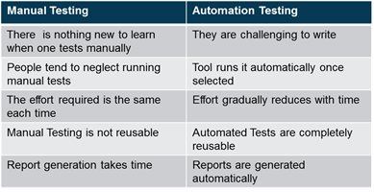
Advantages of Automation over Manual

Slide 8
Some Features of Selenium over other tools
Feature | Selenium
Language Support | Java, C#, Ruby, Python, Perl PHP, Javascript
Windows (Non-browser) based Application support | No
Software Cost | Zero. Free of Cost
Browser support | Google Chrome , Internet Explorer , Firefox , etc
Environment Support | Windows , Linux , Solaris OS X , Others (If brower & JVM or Javascript support exists)
Product Support | Open Source Community

Slide 9
What is Selenium?
Selenium automates browsers.
It is a testing framework for automating web applications.
Selenium scripts run on browsers like IE, Mozilla Firefox, Safari, Opera, Google Chrome, etc., and across operating systems like Microsoft Windows, Linux, Mac, etc.
06
SeleniuM Training

Slide 10
Selenium components
Selenium IDE
An add-on to Mozilla Firefox
Record and playback tool
Export script to various languages
Selenium Remote Control
Contains two components - Selenium Server and Client libraries
Selenium Server: launches and kills browsers, performs different actions.
Client libraries: interface for different programming languages
Selenium WebDriver (Selenium 2.0)
Selenium 1.0 + WebDriver = Selenium 2.0
07
SeleniuM Training

Slide 11
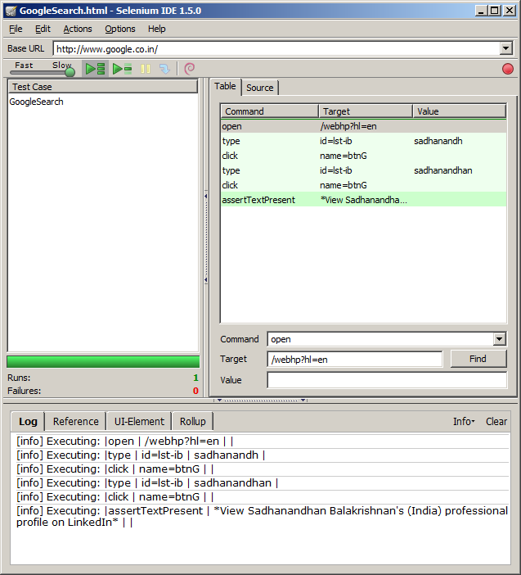
Selenium IDE
The default recorded script is in Selenese, a form of HTML
All the commands are present within the IDE, and easier to code
The field selections or the locators are intelligently selected by the IDE when the scripts are recorded
08
SeleniuM Training

Slide 12
Selenium Commands
The most common methods:
open(String url)
click(String locator)
type(String locator, String value)
select(String locator, String optionLocator)
check(String locator)
waitForPageToLoad(String timeoutInMilliseconds)
Methods for getting information about a page:
getTitle()
getText(String locator)
getValue(String locator)
isEditable(String locator)
isElementPresent(String locator)
getSelectedLabel(String locator)
getSelectedValue(String locator)
isSomethingSelected(String locator)
isChecked(String locator)
getAlert()
SeleniuM Training

Slide 13
Selenium WebDriver
Selenium-WebDriver makes direct calls to the browser using each browser’s native support for automation
It aims to provide a friendly API that’s easy to explore and understand, which will help to make your tests easier to read and maintain.
It’s not tied to any particular test framework, so it can be used equally well in a unit testing or from a plain old “main” method
WebDriver acts just as any normal library: it is entirely self-contained; we don’t need to remember to start any additional processes or run any installers before using it
10
SeleniuM Training

Slide 14
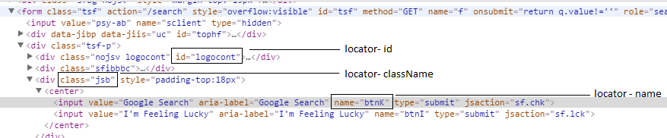
Element Locators
Class Name
cssSelector
Id
Link Text
Name
Tag Name
Xpath
11
SeleniuM Training

Slide 15
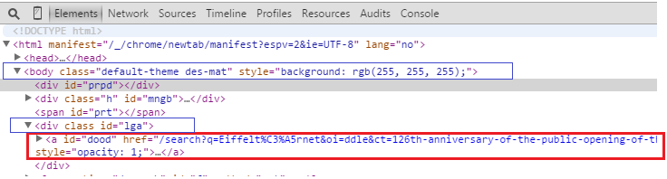
Xpath
In the above html, if we need to identify tag <a>, xpath will be,
Xpath: //a[@id=’dood’]
In the above html, if we need to identify tag <a>, from parent tag <div class id=”lga”>, xpath will be
Xpath: //div[@id=’lga’]/a
In the above html, if we need to identify tag <a>, from parent tag <body>, xpath will be
Xpath: //body/div[3]/a (notice that we have not used attribute with body since its unique)
12
SeleniuM Training

Slide 16
Developer Tools
Internet Explorer
IE Developer Toolbar
IE 6, 7 - http://www.microsoft.com/download/en/details.aspx?id=18359
IE 8, 9 - Integrated
Mozilla Firefox
Add-ons
Firebug - http://getfirebug.com
Firepath - https://addons.mozilla.org/en-US/firefox/addon/firepath/
Xpath checker - https://addons.mozilla.org/en-us/firefox/addon/xpath-checker/
Xpather – http://xpath.alephzarro.com
Opera
DragonFly - Integrated
Chrome/Safari
Web Inspector - Integrated
13
SeleniuM Training

Slide 17
Sample WebDriver Test
public class Selenium2Example {
public static void main(String[] args) {
// Create a new instance of chrome driver.
System.setProperty("webdriver.chrome.driver","chromedriver.exe");
WebDriver driver = new ChromeDriver();
// And now use this to visit Google
driver.get( "http://www.google.com" );
//Find the text input element by its name
WebElement element = driver.findElement(By.name( "q" ));
// Enter something to search for
element.sendKeys( "Cheese!" );
// Now submit the form. WebDriver will find the form from the element
element.submit();
// Check the title of the page
System.out.println( "Page title is: " + driver.getTitle());
//Close the browser
driver.close();
driver.quit();
}
}
14
SeleniuM Training

